Slide 1
Pattern Recognition
Chapter 3: Probability measures for pattern classification _part II

Slide 2
Outline
MAP classifier for Normal Distributions
Performance of the Bayes Classifier
Error bounds

Slide 3


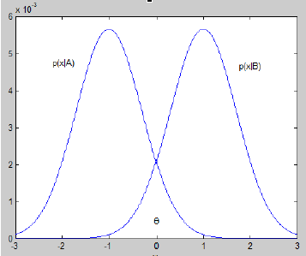
MAP classifier for Normal Distributions
By far the most popular conditional class distribution model is the Gaussian distribution:

Slide 4
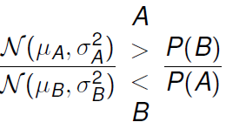
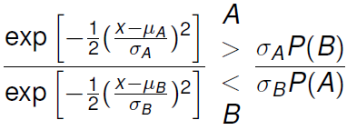
MAP classifier for Normal Distributions
For the two-class case where both distributions are Gaussian, the following MAP classifier can be defined as:

Slide 5
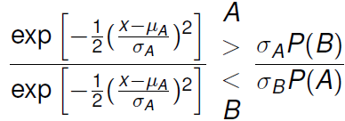
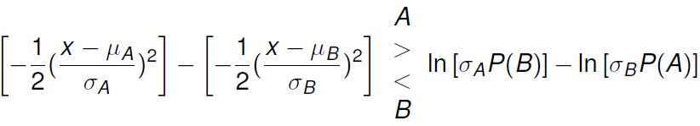
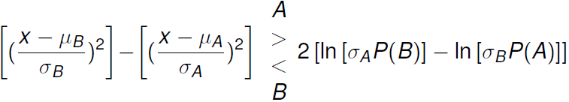
MAP classifier for Normal Distributions
The log-likelihood form:
Final form

Slide 6
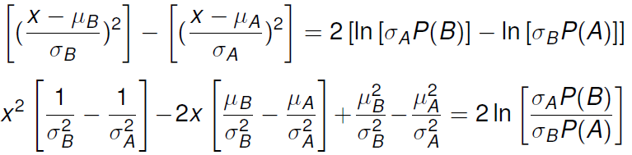
MAP classifier for Normal Distributions
The decision boundary(threshold) for the MAP classifier where P(x|A) and P(x|B) are Gaussian distributions can be find by solving the following expression for x:

Slide 7


MAP classifier for Normal Distributions: Example 1
For case where
….
….
….
We get
Therefore, for this case the MAP rule reduces to a threshold midway between the means.

Slide 8
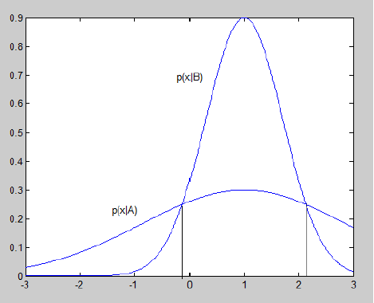
MAP classifier for Normal Distributions: Example 1
For case where , the threshold shifts and as second threshold appears as the second solution to the quadratic expression.

Slide 9
MAP classifier for Normal Distributions: Example 1
Suppose that, given a pattern x, we wish to classify it as one of two classes: class A and class B.
Suppose the two class have patterns x which are normally distributed and the means are known as
Suppose that in a previous case that 4 patterns belong to class A and 6 patterns belong to class B, and both classes have the same standard deviation of 20.
What is the MAP classifier?

Slide 10
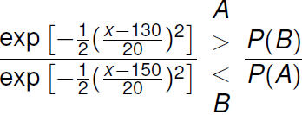
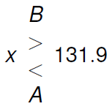
MAP classifier for Normal Distributions: Example 1

Slide 11


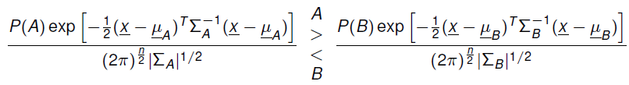
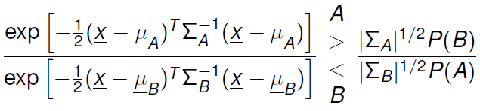
N-dimensions case
For the n-d case

Slide 12
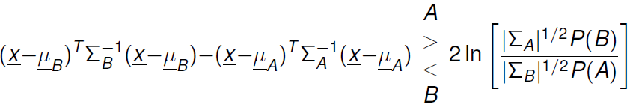
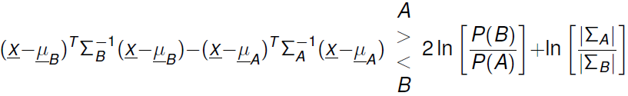
N-dimensions case
Taking the log and simplifying:
Looks familiar?

Slide 13

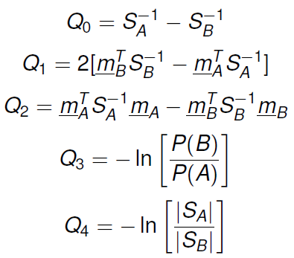
N-dimensions case
The MAP decision boundaries if our classes can be characterized by normal distributions:

Slide 14
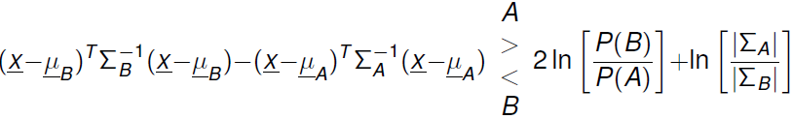
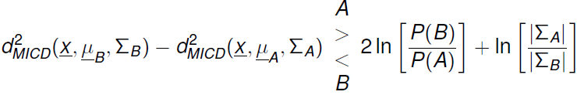

Relationship between MICD and MAP for Normal Distributions
You will found the terms on the left has the same form as the MICD distance metric!
If
then the MAP classifier becomes just the MICD classifier! Which is better?

Slide 15

Relationship between MICD and MAP for Normal Distributions
Therefore, the MICD is optimal in terms of probability of error only if we have multivariate normal distributions that have:
  Equal a prior probabilities (P(A)=P(B))
  Equal volume cases
If that is the case, what’s so special about
  First term biases decision in favor of more likely class according to a priori probabilities.
  Second term biases decision in favor of class with smaller volume

Slide 16


Relationship between MICD and MAP for Normal Distributions
Under what circumstance does MAP classifier perform better than MICD?
Recall the case where we have only one feature(n=1), m=0, and s_{A}≠s_{B}
The MICD classification rule for this case is:
The MICD classification rule decides in favor of the class with the largest variance, regardless of x

Slide 17


Relationship between MICD and MAP for Normal Distributions
The MAP classification rule for this case is:
If P(A)=P(B)

Slide 18
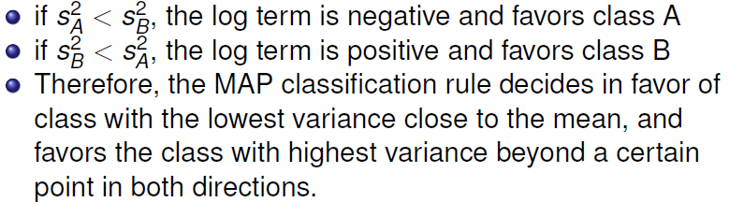
Relationship between MICD and MAP for Normal Distributions

Slide 19
Performance of the Bayes classifier
How do we quantify how well the Bayes classifier works?
Since the Bayes classifier minimizes the probability of error, one way to analyze how well it does is to compute the probability of error P(ε) itself.
Allows us to see the theoretical limit on the expected performance, under the assumption of known probability functions.

Slide 20
Probability of error of given pattern
For any pattern x such that P(A|x)>P(B|x):
x is classified as class A
The probability of error of classifying x as A is P(B|x)
Therefore, naturally, for any given x the probability of error P(ε|x) is:
P(ε|x)=min[P(A|x), P(B|x)]
Rationale: Since we always chose the maximum posterior probability as our class, the minimum posterior probability would be the probability of choosing incorrectly.

Slide 21
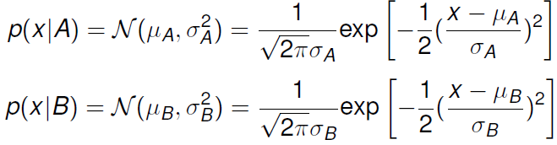
For example
Recall our previous example of a 1-D case:
For x=140, what is the probability of error P(ε|x)?

Slide 22

Expected probability of error
Now if we were to define decision regions R_{A} and R_{B}:
  R_{A}={x|such that P(A|x)>P(B|x)}
  R_{B}={x|such that P(B|x)>P(A|x)}
The expected probability of error can be defined as:
Rationale: For all patterns in R_{A}, the probability of A will be the maximum between A and B, so the probability of error of patterms in R_{A} is just the minimum probability (in this case, the probability of B), and vice versa.

Slide 23
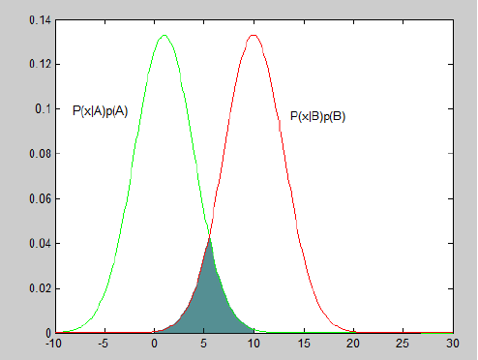
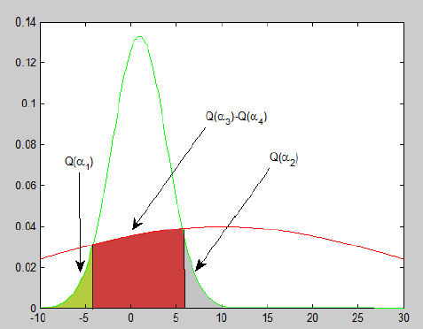
Visualization of Expected probability of error
P(ε) is essentially the shaded area!

Slide 24
Error bounds
In practice, the exact P(ε) is only easy to compute for simple cases as shown before.
So how can we quantify the probability of error in ‘not-simple’ cases?
Instead of finding the exact P(ε) ,we determine the bounds on P(ε) , which are:
  Easier to compute
  Leads to estimates of classifier performance.

Slide 25
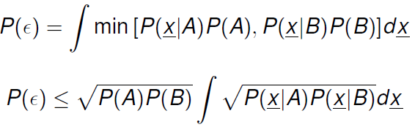
Error bounds
Using the following inequality:
min[a,b]≤sqrt(a*b)
The following holds true:
What’s so special about this?
Answer: you don’t need the actual decision regions to compute this!

Slide 26


Bhattacharrya bound
Since P(A)+P(B)=1 and the Bhattacharrya coefficient ρ can be defined as:
The upper bound (Bhattacharrya bound) of P(ε) can be written as

Slide 27
Bhattacharrya bound: Example
Consider a classifier for a two class problem. Both classes are multivariate normal. When both classes are a priori equally likely, the Bhattacharrya bound is P(ε) ≤0.3
New information is specified, such that we are told that the priori probabilities of the two classes are 0.2 and 0.8, for A and B respectively.
What is the new upper bound for the probability of error?

Slide 28
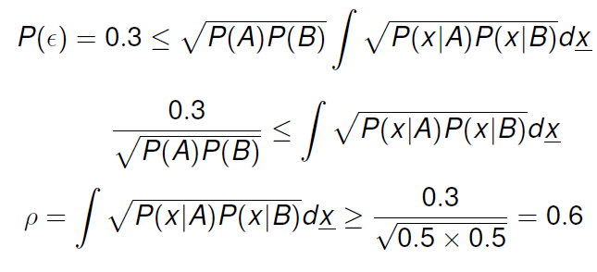
Bhattacharrya bound: Example
Step 1: based on old bound, compute the Bhattacharrya coefficient

Slide 29
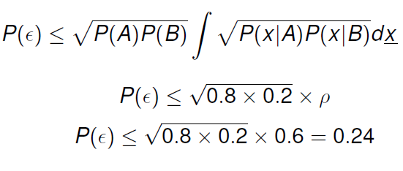
Bhattacharrya bound: Example
Step 2: based on Bhattacharrya coefficient and new priors P(A)=0.2 and P(B)=0.8, the new upper bound can be computed as:

